Slide 1
Successfully Communicating
With Peers and Colleagues
Kevin Kline, Principal Program Manager, SentryOne

Slide 4

Kevin Kline
Founder & Past President of PASS
Kevin was one of the original nine independent founders of PASS and served two terms as president from 2004-2008.
Principal Program Manager,
SentryOne
Industry Expert
Kevin authored his first technology book out of 11 (on Oracle, gasp!) in 1994. His best-known book is SQL in a Nutshell, a best-seller. He has been a Microsoft Data Platform MVP since 2003.
/KEKline
@KEKline
KEKline

Slide 5


PASS Summit Learning Pathway: Communication & Collaboration
Successfully Communicating with Peers and Colleagues
Kevin Kline
Wednesday, November 06, 1:30 PM
Room 400
Successfully Communicating with Your Customers
Denise McInerney
Thursday, November 07, 1:30 PM
Room 400
Successfully Managing Upwards and Getting Your Boss on Your Side
Edwin Sarmiento
Friday, November 08, 11:00 AM
Room 3AB

Slide 7
Agenda
It Begins with Self-awareness
Communication Best Practices
Persuasion and Influence
The Power of Storytelling
Wrap-up

Slide 8
Introductory Concepts

Slide 9
The Communication Process
Message
Medium / Channel
RECEIVER
Noise
Encoding
Decoding
SENDER
Feedback
Message
Notes:
What is communication? Simply the transfer and understanding of meaning. To be successful, the meaning of what a person wants to convey must be received and understood.
Why communicate? In many social situations, the old adage of “Report vs Rapport” actually applies.
Noise can also be broken down into subtypes, such as filtering, selective perception, bias, information overload, emotional overload, jargon, gender, and culture.

Slide 10







Non-verbal Communications
When face to face, 65-90% of message is communicated through non-verbal methods
Body language: gestures, facial expressions, posture, and demeanor
Intonation: verbal emphasis and cadence given to specific words and phrases
Symbols: Images and accoutrements that convey added meaning and context to a conversation
Notes:
There are seven universal expressions for all humans everywhere: anger, fear, disgust, happiness, sadness, surprise, and contempt. There are seventeen (inclusive of the previous 7) that are almost universal.
Dominant and submissive body language.
https://www.cbc.ca/natureofthings/features/the-seven-universal-emotions-we-wear-on-our-face

Slide 11
Non-verbal Communications
When face to face, 65-90% of message is communicated through non-verbal methods
Body language: gestures, facial expressions, posture, and demeanor
Intonation: verbal emphasis and cadence given to specific words and phrases
Symbols: Images and accoutrements that convey added meaning and context to a conversation
Notes:
There are seven universal expressions for all humans everywhere: anger, fear, disgust, happiness, sadness, surprise, and contempt. There are seventeen (inclusive of the previous 7) that are almost universal.
Dominant and submissive body language.
https://www.cbc.ca/natureofthings/features/the-seven-universal-emotions-we-wear-on-our-face

Slide 12
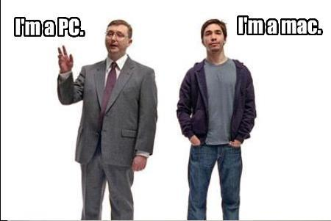
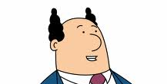
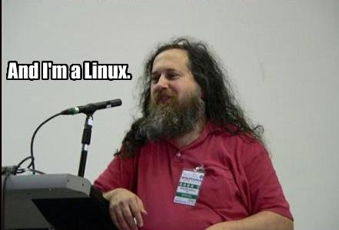
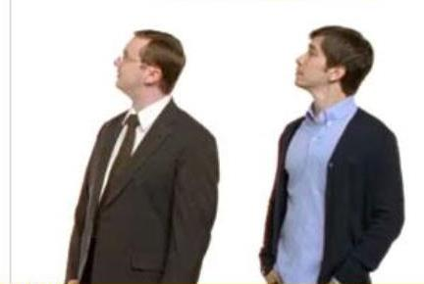
It Begins with Self-Awareness
DISC: Free test at
http://www.123test.com/disc-personality-test/
Myers-Briggs (MBTI): Free test at
http://www.humanmetrics.com/cgi-win/jtypes2.asp

Slide 13
It Begins with Self-Awareness
Self-discovery for your own style and preferences:
DISC
Immediately applicable to communication
Measurements - Dominance, Inspiration, Stability, and Compliance
Free test at http://www.123test.com/disc-personality-test/
Myers-Briggs Type Indicator (MBTI)
Most useful for self-discovery, but still used by 80% of the Fortune 500.
Measurements – Introversion ⬄ Extroversion, Sensing ⬄ Intuition, Thinking ⬄ Feeling, and Judging ⬄ Perceiving
Free test at http://www.humanmetrics.com/cgi-win/jtypes2.asp
Big-Five Factor Markers
The most trusted and scientifically sound psychometric test
Measurements - Openness, Conscientiousness, Extraversion, Agreeableness, and Neuroticism
Free test at https://openpsychometrics.org/tests/IPIP-BFFM/
Notes:
DISC is a behavior assessment tool that was developed by Industrial psychologist Walter Vernon Clarke and is based on the theory of psychologist William Moulton Marston.
MBTI is based on the theory of psychology Carl Jung and seeks only to define a person’s innate preferences.
Big Five, Five Factor, and OCEAN are all ways of describing the same theory of personality. Multiple psychological studies have arrived at the conclusion that the differences between people's personalities can be organized into five broad categories, called the Big Five or Five Factors. These are sometimes referred to as the five broad dimensions of personality. The Five Factors of personality are:
Openness - How open a person is to new ideas and experiences
Conscientiousness - How goal-directed, persistent, and organized a person is
Extraversion - How much a person is energized by the outside world
Agreeableness - How much a person puts others' interests and needs ahead of their own
Neuroticism - How sensitive a person is to stress and negative emotional triggers
This Big Five assessment measures your level of each of the Big Five traits and shows your scores as they compare with an international sample of people of all ages.

Slide 14

The Link Between Communication, Advancement, and Leadership
Good leaders practice skills in four broad categories:
Coaching
Facilitating good communications
Supporting change and ideas
Meeting team goals
Where are the technology skills?
Notes:
Are you ambitious? Then deliberately practice your communication skills. Managers ultimately get things done through other people and are therefore directly linked to their communication and interpersonal skills. US DOD’s strongest indication that a top cadet will make the rank of general? Freshman comp.
Coaches are not supervisors. Coaches don’t have to give the “right” answer to a problem and may not even know it. A coach is more of a sounding board, supportive critic, a source of facts and broad experience, and a devil's advocate. Supporting innovation (change and ideas) critical in technical teams yet studies show that most organizations stifle innovation and undermine effective change. Facilitating good communications is essential because you are the conduit between your hopefully empowered team members and middle- or top-management. You must build trust below so that information isn’t suppressed while being an advocate to higher mgt.

Slide 15
Communication Best Practices

Slide 16
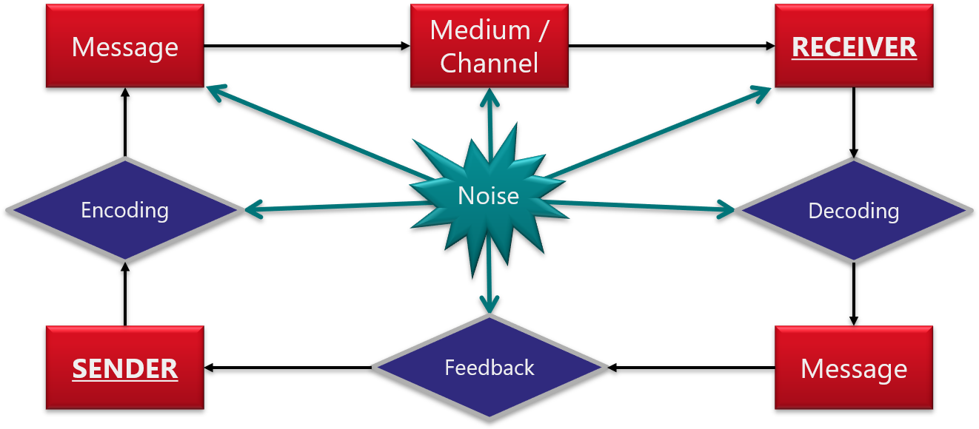
The Communication Process
Notes:
What is communication? Simply the transfer and understanding of meaning. To be successful, the meaning of what a person wants to convey must be received and understood.
Why communicate? In many social situations, the old adage of “Report vs Rapport” actually applies.
Noise can also be broken down into subtypes, such as filtering, selective perception, bias, information overload, emotional overload, jargon, gender, and culture.

Slide 17
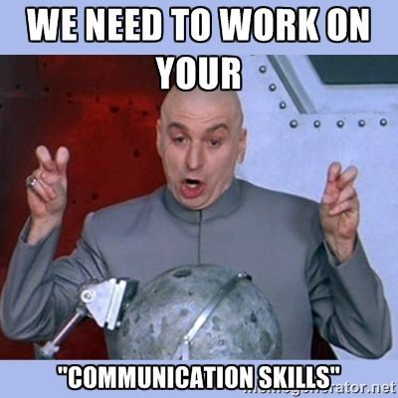
I am the Sender
Consider the Receiver subjectively when crafting your message.
Use typing, if available.
“Read the Room!”
Remember – B.L.U.F.
Strive for brevity. Value the Receiver’s time. Stay focused.
Be aware that you’re communicating even when you say nothing.
Clothing – Posture – Demeanor – Eye contact – Biases
Remember that there is a law of reciprocity in social and interpersonal situations.
Very important comms? Get a friend to do a read-thru.
Don’t be “that IT guy”.
Be patient with non-techies
Teach … with a positive attitude
Notes:
BLUF = Bottom Line Up Front

Slide 18
Encoding, Message, & Medium
Clarify facts from values/opinions
Avoid jargon and information overload
Other noise problems include filtering (especially upwards), selective perception, bias, emotional overload, gender bias, and cultural biases
Make generous use of relatable analogies or familiar examples
Use analogies and examples that the Receiver finds meaningful
Use the right medium / channel:
IM / Slack / Teams – disposable, ephemeral
Email – archivable, historical
Call – lots of back-n-forth, lots of details/info to convey
What if the message is highly-emotional or top priority?

Slide 19
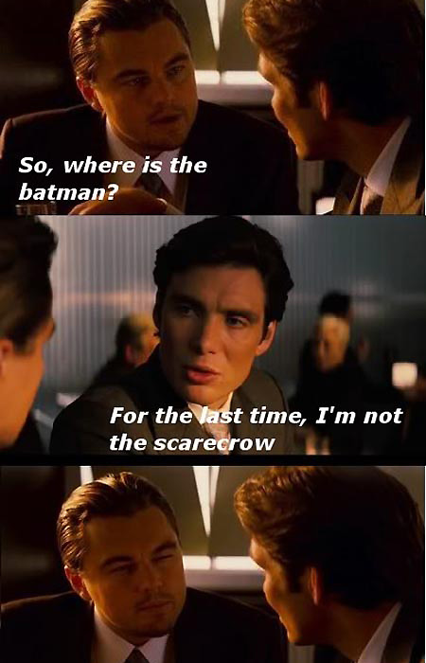
I am the Receiver
Be “fully present”. Be respectful.
Good listening skills involve:
Acknowledging statements
Summarizing
Empathizing
Good questioning skills involve:
Getting the specifics
Seek fact vs. value
Use open vs. closed questions
Observing reaction
Ninja secret: Understand the power of silence!
Notes:
Make sure, when asking specific questions, that it’s obvious whether you want factual or value/opinion answers. PRESS FOR SPECIFICS!
When acknowledging, extra effort (turning off the cell phone) builds self-esteem.
When summarizing, don’t show approval or disapproval.
Empathizing goes beyond summarizing – it shows that you understand feelings. It reduces or diffuses emotional responses where logical responses actually elevates emotions.
Practice the Uncomfortable: long, thoughtful pauses
Factual vs Value Information
Open vs Closed Questions
Pressing for specifics
Testing for reaction
In responsing:
Paraphrase
Acknowledge
When asking specific questions, explicitly probe for factual or value/opinion answers.
When acknowledging, extra effort (turning off the cell phone) builds trust and credibility.
When summarizing, don’t show approval or disapproval.
Empathizing goes beyond summarizing – it shows that you understand feelings.

Slide 20

Happy Boss, or How Communicate Upwards
What is their motivation? Are they rational?
Demonstrate that you understand the business and what the business needs. What does the Boss need to be considered successful?
Be proactive, especially when communicating upward:
Learn how to brag the right way
Schedule written updates, even when they’re not required
Speak their language:
Are they a technologist?
Are they detail oriented?
What’s the common ground, opportunity for analogy, storytelling?

Slide 21
Persuasion Techniques

Slide 22
Use the 8 Techniques for Direct influence
Using communication to change behaviors
Rational Appeal
Intimidation
Inspirational Appeal
Flattery
Alliances
Appealing up
Consultation
Call in a debt / favor

Slide 23
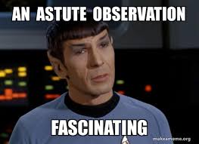
Logical Appeals
Rational Appeal versus Intimidation
When and How?
When your audience is rational
Build a case of rational facts
Make a careful SWOT analysis
Use a proposal or “suggestion” format
Make a pitch and then explicitly follow-up
Notes:
Rational appeals aim to achieve something new, most often a specific decision. Intimidation uses the same approach, but is designed to mitigate risk or thwart something bad, e.g. the universe is going to “getcha” and FUD.
By appeal to reason: Logic, Logical argument, Rhetoric, Scientific evidence (proof), and Scientific method

Slide 24
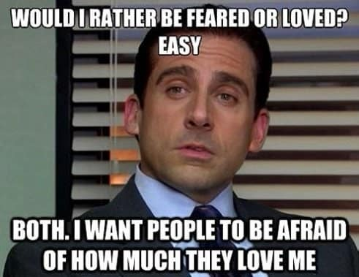
Emotional Appeals
Inspirational Appeal versus Flattery
When and How?
When your audience is motivated by values
Appeals to our “better selves”
Requires strong, in-person delivery
Make a pitch and then explicitly follow-up
Notes:
Emotional appeals are the most powerful method of changing behaviors, both in short- and long-term
Used by: Advertising, Faith, Presentation and Imagination
Abused by: Propaganda, Pity, Seduction, and sometimes Tradition

Slide 25
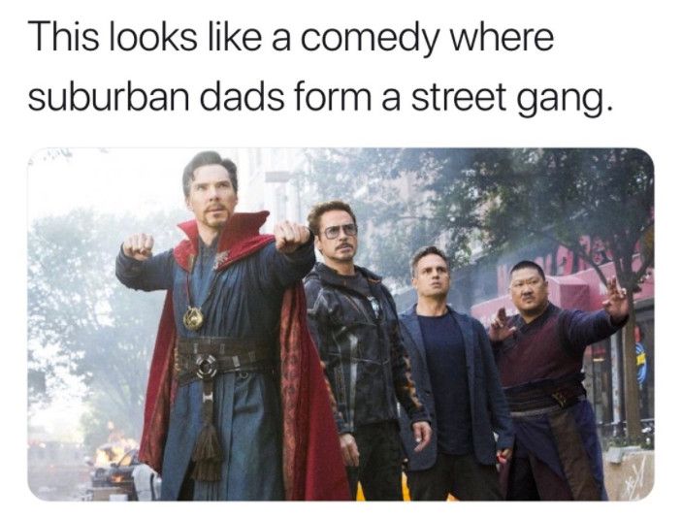
Cooperative Appeals
Consultation | Alliance | Call in a debt / favor
When and how?
When your audience is similarly inclined
Recognize the transactional nature
Aim for “WIIFM” approach or “Doing well by doing good”
Appealing up
When and how?
Only in the face of serious obstacles
Recognize the potential for “paybacks”

Slide 26
The Power of Storytelling
It applies to you, Data Pro

Slide 27
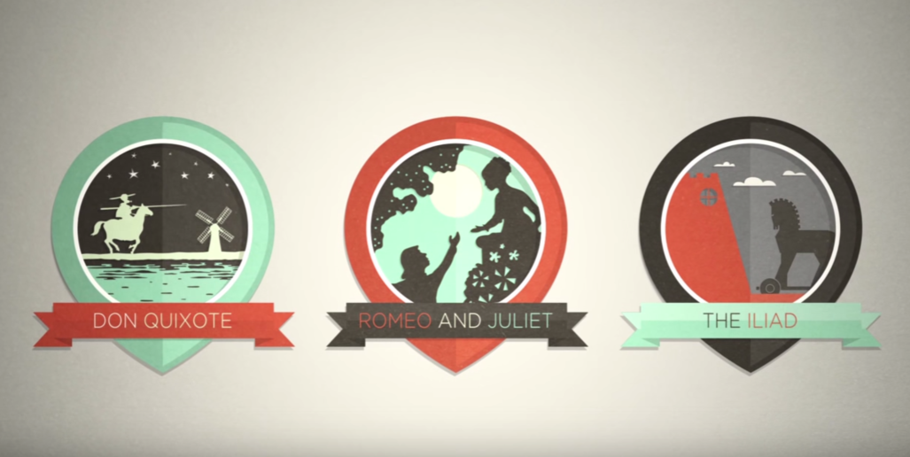
Notes:
First, let’s talk about stories. Stories are important because they are meaningful.
They resonate within our psyche and help us to determine our baseline for decision-making. That is, our VALUES. If you want to always score credibility points, even for snap judgements, then evaluate and respond IN TERMS OF THE SHARE VALUES OF THE TEAM.

Slide 28
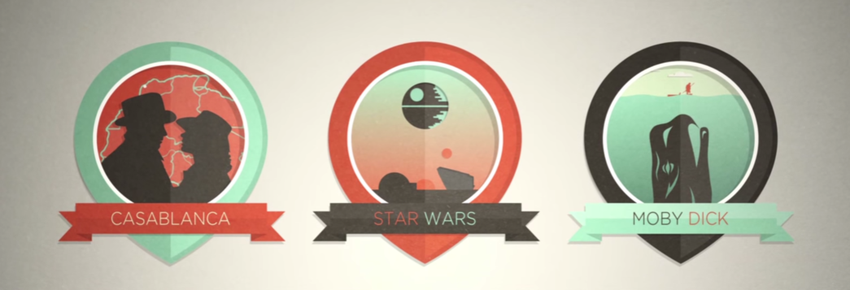
MEMORABLE
IMPACTFUL
PERSONAL
Notes:
Memorable: data and statistics are processed solely by the parts of the brain that process language. There is no emotional component to that brain process. Stories, on the other hand, can engage the entire brain, including emotions and even sensory regions of the brain.
Impact is measured in terms of impact on a single human. Statistics do not persuade. Use the anecdote of college fundraisers.
Personal stories connect to an emotionally significant component of the person’s psyche. Why do teenagers love horror movies? Because being scared resonates with them emotionally as they go through monumental hurdles of meeting new people, going to new schools, worry about bullies or fitting in. Meaning can be extract from a story only where there’s a personal connection. And when a story is well told, they connect not just with the characters in the story, but also with the storyteller. Use the anecdote about collegiate fund raising.

Slide 29
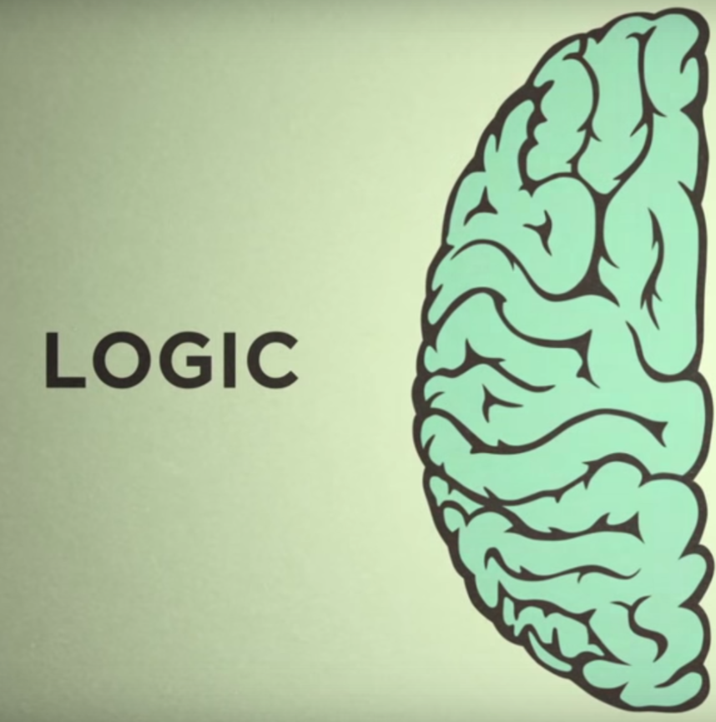
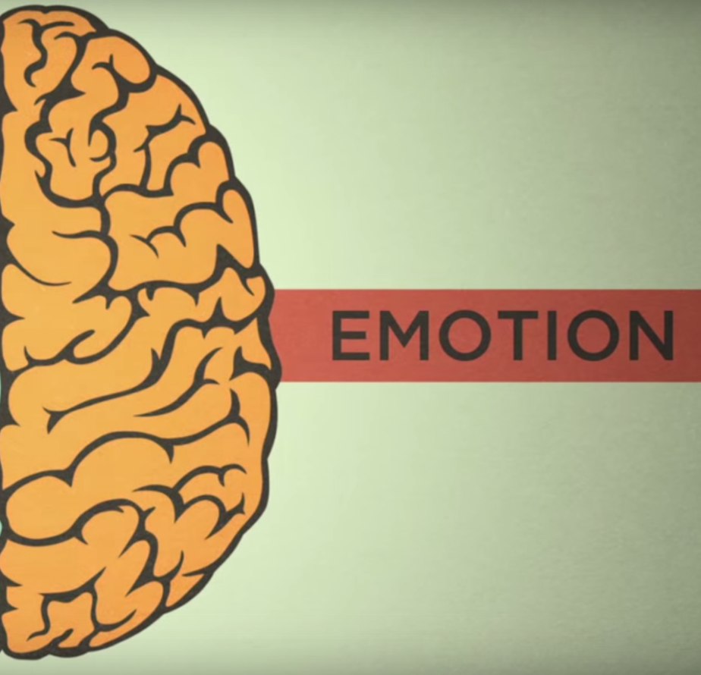
Notes:
Conventional wisdom used to say that ppl make decisions from a rational place.
What science now shows is that we make decisions based on our emotions … and then later use logic, facts, and data to back up those decisions.

Slide 30
DATA
+
STORY

Slide 31
=
Intellectual Connection
Emotional Connection
If history were taught in the form of stories, it would never be forgotten.
-Rudyard Kipling
Notes:
For lasting effect, you must connect with the emotional brain, but also resonate with the intellectual brain.
Data is one form of curations. So are stories.

Slide 32
Resources
http://www.ccl.org/leadership/index.aspx
My favorite leadership training organization
http://www.techrepublic.com/blog/tech-manager
Good on-line resource with lots of topical content and forums
http://www.sqlpass.org
Professional development vChapter

Slide 33
Wrap-up
Awareness:
Self-awareness. Know your strengths and weaknesses.
Tailor your message to your Receiver’s preferences.
Remember the best practices. Practice, if needed.
Persuasion:
8 techniques in 3 categories: logical, emotional, cooperative
Choose the technique that’s best for your audience.
Good Storytelling – Memorable, Impactful, Personal (MIP)
Persuasive storytelling – Data/Facts + Emotions/Values

Slide 34
Kevin Kline
@KEKline
kkline@SentryOne.com

Slide 35
The Power of Personality Interplay
Knowing your team dynamic enables:
Better alignment to meet team goals
Happier team members
Easier delegation
Less team friction
Higher performance team = Higher performance manager!
What’s better, to shore up weakness or further improve strengths?

Slide 36
Leveraging Personality Types
Several great tests reveal distinct and reliable personality types, each with strengths and weaknesses.
All on-line and free:
Myers-Briggs Type Indicator (MBTI)
DISC assessment
Big Five Factor
FIRO-B, Campbell Strength Finder, Colors Assessment and others
Trust and credibility are the linchpins of a leaders’ influence and authority.
Notes:
You earn trust and achieve credibility in different ways according to the personality types of your staff.

Slide 37
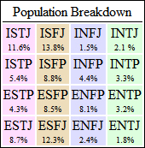
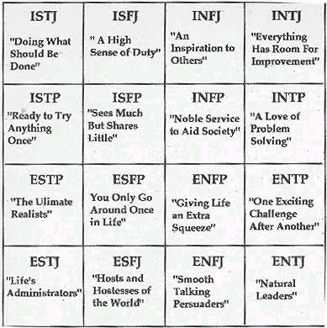
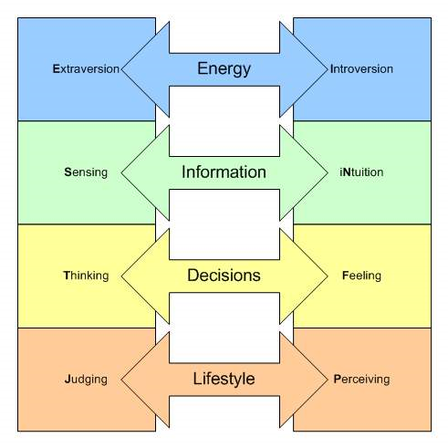
MBTI

Slide 38
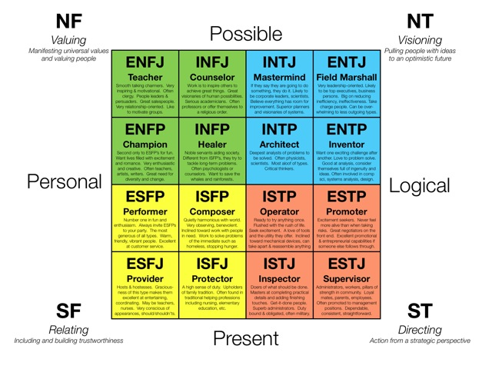
MTBI, Part 2

Slide 39
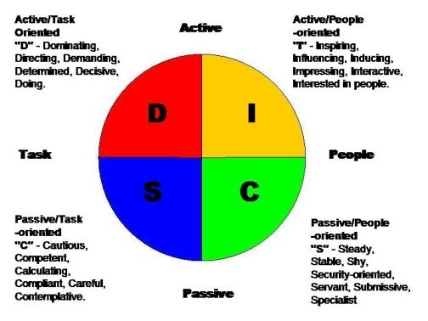
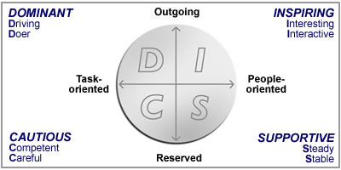
DISC

Slide 40
Ten Minute DISC
Determined Convincing Predictable Cautious
Strong-willed Persuasive Easy-going Orderly
Direct Expressive Kind Analytical
Bold Sociable Cooperative Precise
Outspoken Animated Patient Logical
Decisive Talkative Loyal Controlled
Daring Outgoing Agreeable Careful
Restless Enthusiastic Considerate Thorough
Competitive Inspiring Consistent Detailed
Aggressive Playful Satisfied Accurate
Notes:
For each of the 10 word groups on the slide, select the word MOST like you and rate it as a 4, the LEAST like you as a 1, and the others in between. There should be a 1, 2, 3, and 4 on each row.
Once values are assigned to all words in all rows, total the points for each column and write the totals at the bottom of the column.
The DISC styles are, in column order, ‘D’ for dominant/driven, ‘I’ for inspiration/influence, ‘S’ for ‘Steady Relater’, and ‘C’ for Cautious Compliance. The book Taking Flight puts these styles into analogies using birds – Eagle, Flamingo, Dove, and Owl respectively.

